Slide 1

MACHINE LEARNING IN R:
supervised classification

Slide 2
“I think we should be very careful about artificial intelligence. If I had to guess at what our biggest existential threat is, it’s probably that. So we need to be very careful,”
Elon Musk

Slide 3
Machine Learning | Statistics
network, graphs | model
focus on prediction | focus on inference
weights | parameters
learning | fitting
generalization | test set performance
supervised learning | regression/classiﬁcation
unsupervised learning | density estimation, clustering
large grant = $1,000,000 | large grant = $50,000
nice place to have a meeting: Snowbird, Utah, French Alps | nice place to have a meeting: Las Vegas in August
http://statweb.stanford.edu/~tibs/stat315a/

Slide 4
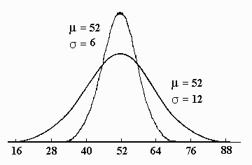

Statistics
Machine Learning
T-Test
Logistic Regression
Elastic Net
Gradient Boosting
Deep Learning

Slide 5
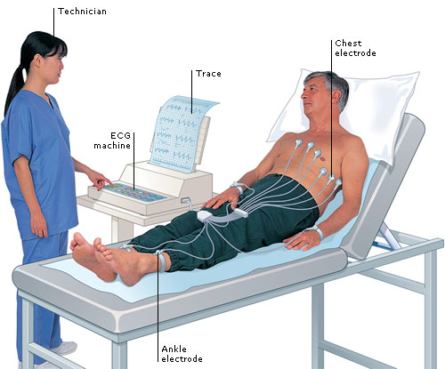
Arrhythmia Data
http://archive.ics.uci.edu/ml/datasets/Arrhythmia

Slide 6
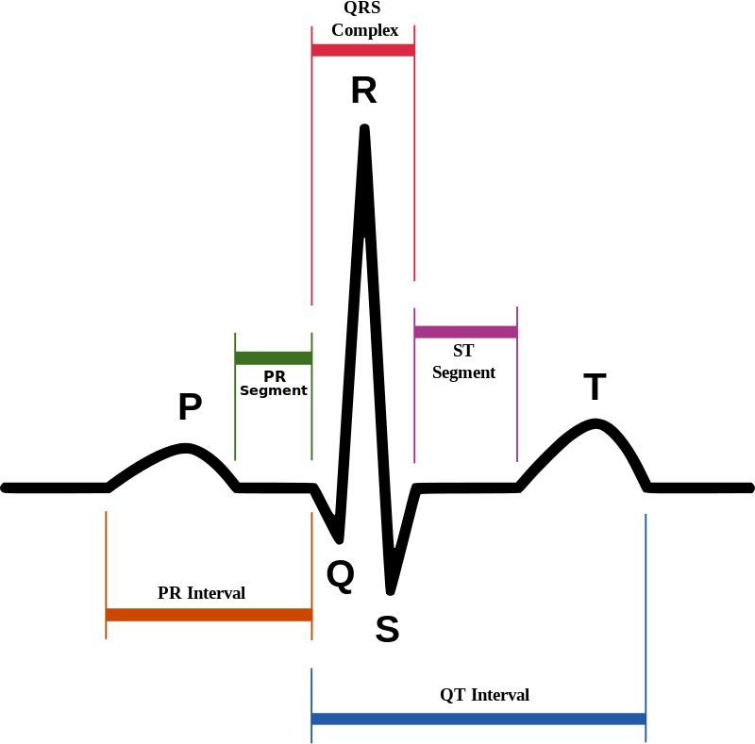
Data
451 observations
245 Normal
206 Abnormal
263 variables
198 continuous
65 binary

Slide 7
Data pre-processing
arrhythmia = read.csv('arrhythmia.csv')
set.seed(120)
# Make folds vector to specify holdout set
folds = sample(1:10, nrow(arrhythmia ), replace = TRUE) response = arrhythmia$abnormal
# Formula for use in model matrix function
fmla <- abnormal ~ sex + di_width_ragged_r_wave + di_width_diphasic_derivation_of_r_wave + …
# Make sparse model matrix
mm = Matrix::sparse.model.matrix( fmla, data = arrhythmia)

Slide 8
Logistic regression
10 events per variable?
Choose 20 ‘best variables’
#fit a logistic regression
glm1 = glm(fmla2,
data = arrhythmia[folds < 9, , drop = TRUE], family = binomial())
#make predictions
p_logistic = predict(glm1,
arrhythmia[folds >= 9, ],
type = "response")
#get predictive accuracy
auc(p_logistic, response[folds >= 9] ) accuracy(p_logistic > 0.5, response[folds >= 9] )
AUC = 70%

Slide 9

THE elastic net
Interpretable models
Good when p>>n

Slide 10
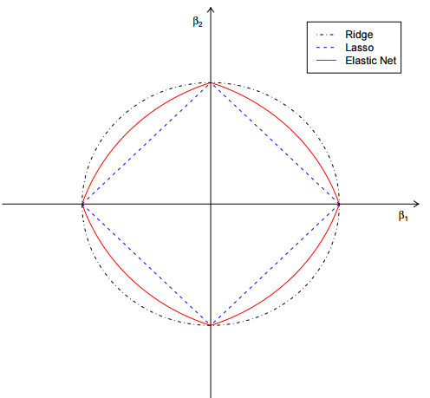
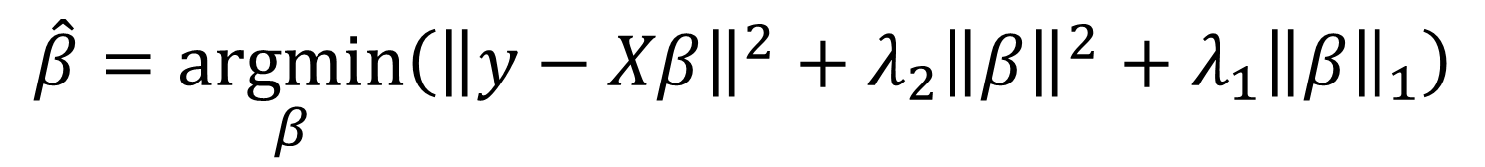
Elastic Net
$$\hat{β}=\underset{β}{argmin}\left({\left\|y−Xβ\right\|}^{2}+λ_{2}{\left\|β\right\|}^{2}+λ_{1}{\left\|β\right\|}_{1}\right)$$

Slide 11
Elastic Net in R
library(glmnet)
#fit model on training set
e_net_default = glmnet( x = mm[folds < 9,],
y = response[folds < 9],
family = "binomial")
#make predictions on test set
p_e_net_default = predict(e_net_default,
newx = mm[folds >= 9,],
type = "response")
str(p_e_net_default )
# num [1:98, 1:100] 0.467 0.467 0.467 0.467 0.467 ...
# - attr(*, "dimnames")=List of 2
# ..$ : chr [1:98] "11" "12" "15" "17" ...
# ..$ : chr [1:100] "s0" "s1" "s2" "s3" ...

Slide 12
Elastic Net in R
#get auc for each prediction
e_net_default_auc = aaply(p_e_net_default, 2, function(.x){
auc(y = response[ folds >= 9], prob = .x)
})
#plot these results
par(mfrow = c(1,2))
plot(e_net_default, xvar = "lambda")
plot(y = e_net_default_auc ,
x = log(e_net_default$ lambda ),
xlab = 'Log Lambda',
ylab = 'AUC', type = 'l', lwd = 2)

Slide 13
Elastic net plots
AUC = 80%

Slide 14

Gradient boosting!
the best off-the-shelf classifier in the world!

Slide 15
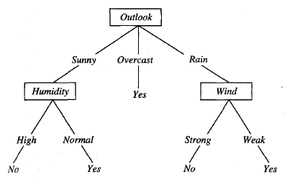
Trees

Slide 16
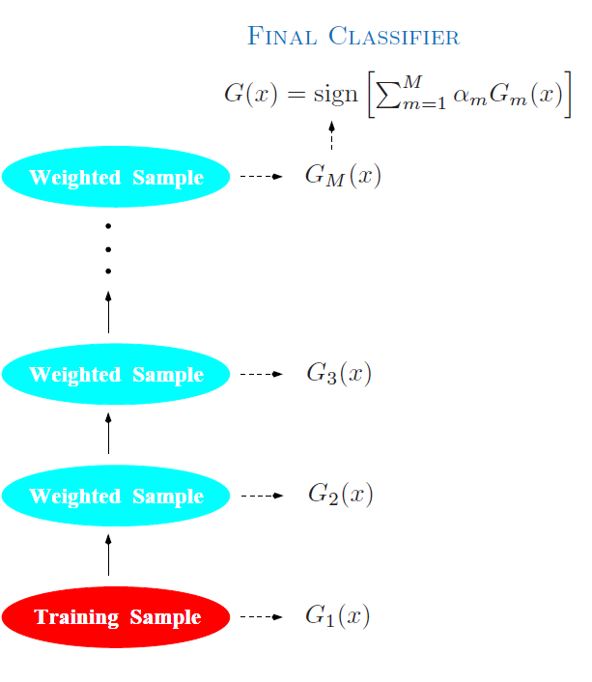
Boosting

Slide 17
Gradient Boosting in R
library(xgboost)
#fits model
boost_default = xgboost(data = mm[folds < 9,],
label = response[folds < 9],
nrounds = 50,
objective = "binary:logistic")
#makes predictions
p_boost_default = predict(boost_default,
mm[folds >= 9,])
auc (p_boost_default, response[folds >= 9] )
accuracy (p_boost_default > 0.5, response[folds >= 9] )
AUC = 83%

Slide 18

Deep Learning is like love
no one is sure what it is, but everyone wants it

Slide 19
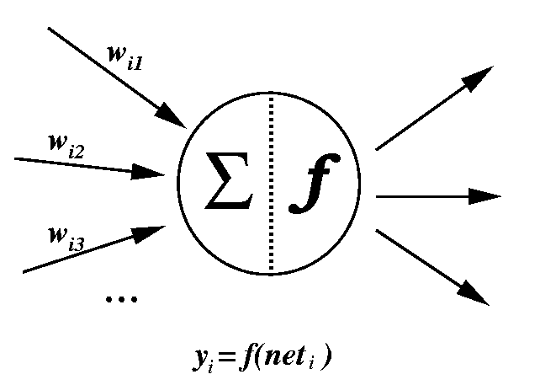
Neural Networks

Slide 20
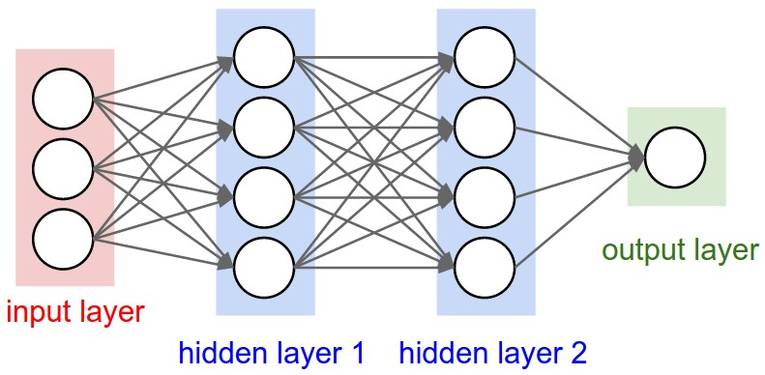
‘Deep’ Neural Networks

Slide 21
Deep Learning in R
library(h2o)
# initialise h2o
localH2O <-h2o.init(ip = "localhost",
port = 54321, startH2O = TRUE)
#get data in h2o format
dat_h2o <- as.h2o(arrhythmia)
#get vector of predictor locations
predictors = which(!names(arrhythmia) %in%
c("arrhythmia", "abnormal" ))

Slide 22
Deep Learning
#fit model
dl_fit <- h2o.deeplearning(x = predictors,
y = 'abnormal',
training_frame = dat_h2o[which(folds < 9),],
epochs = 50)
#make predictions
pred_dl <- h2o.predict(dl_fit,
dat_h2o[which(folds >= 9) , ])
pred_dl <- as.data.frame(pred_dl)
auc( pred_dl$`TRUE.`, response[folds >= 9])
accuracy( pred_dl$`TRUE.`, response[folds >= 9])
AUC = 84%

Slide 23
Results
Model | AUC
Logistic Regression | 70
Elastic Net | 80
Gradient Boosting | 83
Deep Learning | 84
Combined model | 85

Slide 24
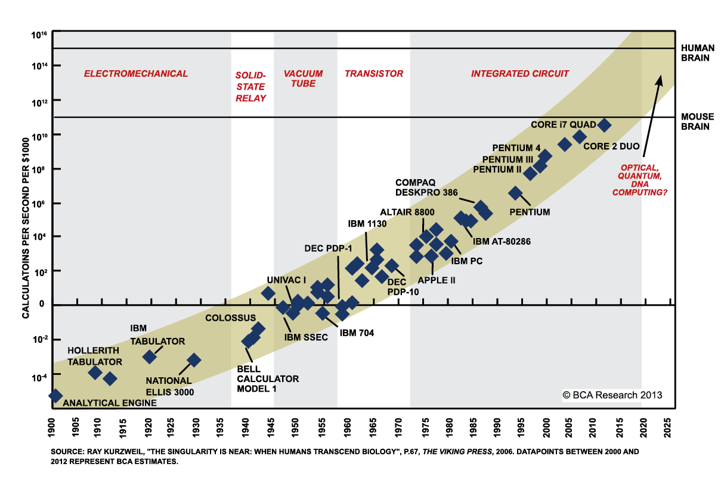
THE SINGULARITY IS NEAR?

Slide 25
Other topics
Cross validation
Tuning parameters
Bias/Variance trade-off
Distributed learning/big data
Unsupervised Learning
Unstructured data
… many more…

Slide 26
Thanks!
Scripts and data available here: https://github.com/tomliptrot/Machine_Learning_ManchesterR/

